Slide 1
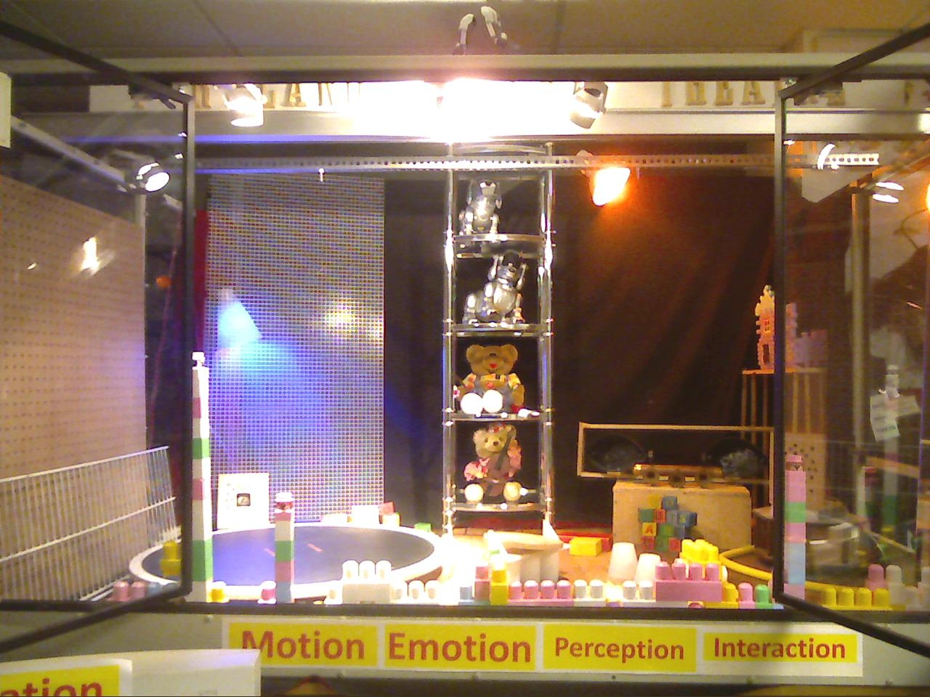
Towards Robot Theatre
Marek Perkowski

Slide 2
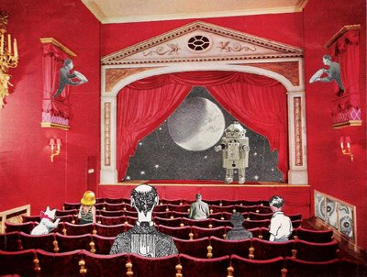
History of robot theatre
Modern robot theatre
Robot theatre at PSU
Models of robot theatre
Research topics on Robot Theatre
Future Robot Theatre

Slide 3
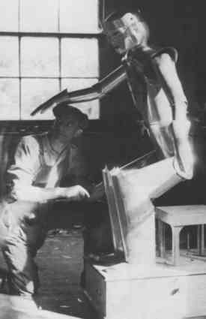
History of Robot Theatre

Slide 4
From antiquity until 1996

Slide 5
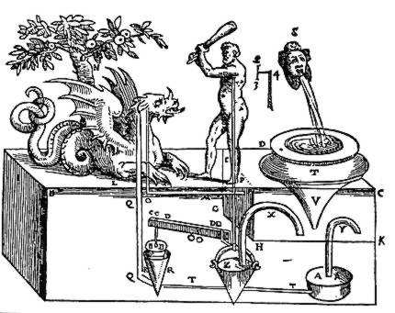
Robot Theatre of Hero of Alexandria
Heron’s Book Automata
A collection of constructions called miracles (thaumata) for temples.
Heron describes automatic rotating objectives, noise such as thunder, automatic opening doors.
Philon from Byzanz describes the existence of automata in his book Mechaniki syntaxis, that includes pneumatic apparatus and automatic astronomical devices as early as 300 BC.

Slide 6
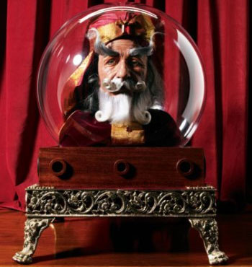
Albertus Magnus and his robot head
Albertus is recorded as having made a mechanical automaton in the form of a brass head that would answer questions put to it.

Slide 7
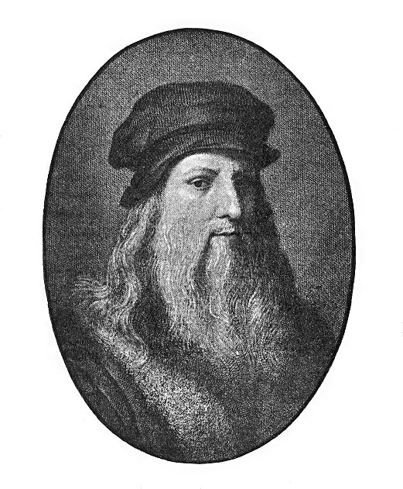
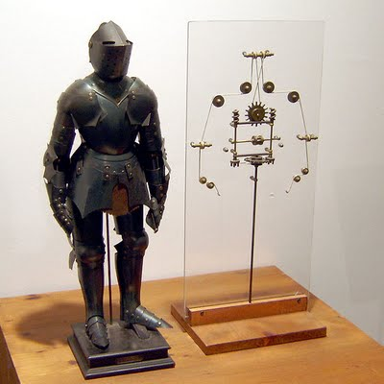
Knight of Leonardo Da Vinci
Leonardo's robot refers to a humanoid automaton designed by Leonardo da Vinci around the year 1495.
The design notes for the robot appear in sketchbooks that were rediscovered in the 1950s.
It is not known whether or not an attempt was made to build the device during da Vinci's lifetime.
Since the discovery of the sketchbook, the robot has been built faithfully based on Leonardo's design; this proved it was fully functional.

Slide 8
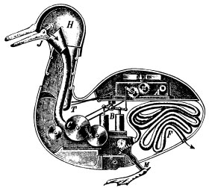
Duck of Vaucanson
The Canard Digérateur, or Digesting Duck, was an automaton in the form of a duck, created by Jacques de Vaucanson in 1739.
The mechanical duck appeared to have the ability to eat kernels of grain, and to metabolize and defecate them

Slide 9
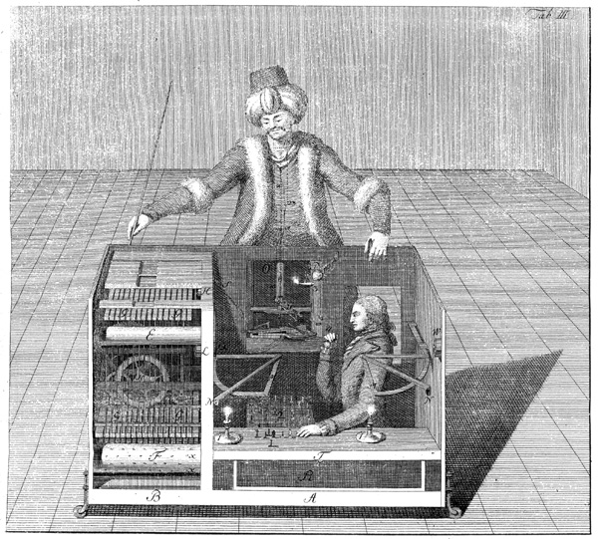
Turk of Kempelen
Constructed and unveiled in 1770 by Wolfgang von Kempelen (1734–1804) to impress the Empress Maria Theresa
The Turk was in fact a mechanical illusion that allowed a human chess master hiding inside to operate the machine.
With a skilled operator, the Turk won most of the games played during its demonstrations around Europe and the Americas for nearly 84 years, playing and defeating many challengers including statesmen such as Napoleon Bonaparte and Benjamin Franklin.

Slide 10
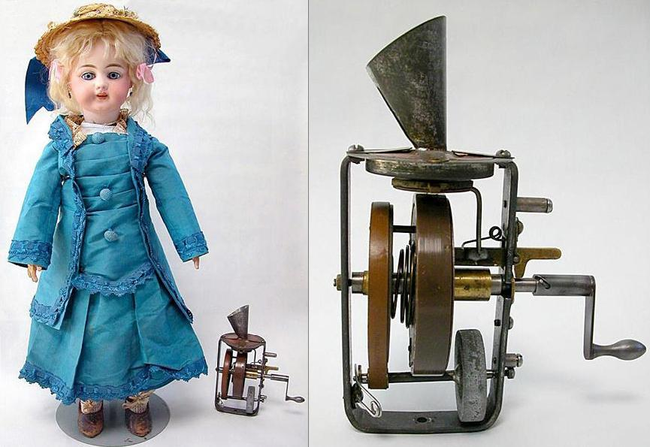
Edison’s Talking Doll
"Despite several years of experimentation and development, the Edison Talking Doll was a dismal failure that was only marketed for a few short weeks in early 1890...

Slide 11
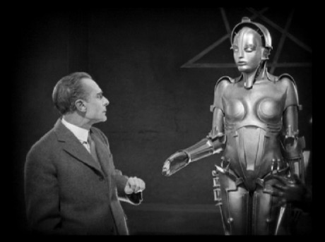
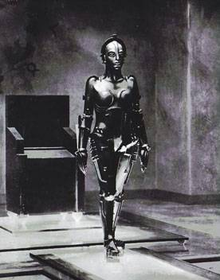
Hel from Fritz Lang's Metropolis 1927
Rotwang brings Maria into his laboratory and transfers her appearance to the machine woman.
Metropolis is set in a futuristic urban dystopia and examines a common science fiction theme of the day: the social crisis between workers and owners in capitalism.

Slide 12
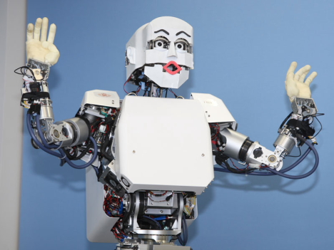
Modern Robot Theatres

Slide 13
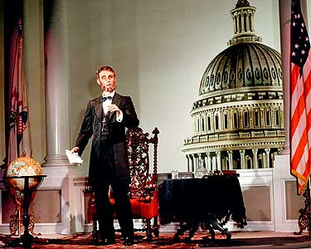
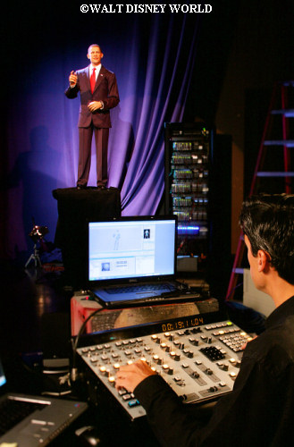
Audio-Animatronics from Walt Disney Imagineering

Slide 14
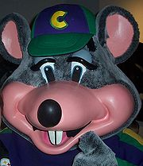
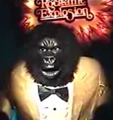
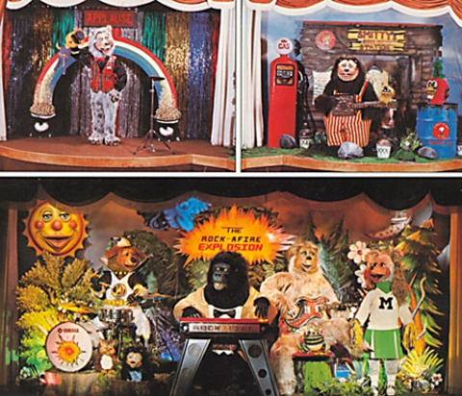
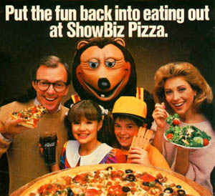
Chuck E. Cheese's Pizza Time Theatre by Nolan Bushnell in 1977

Slide 15
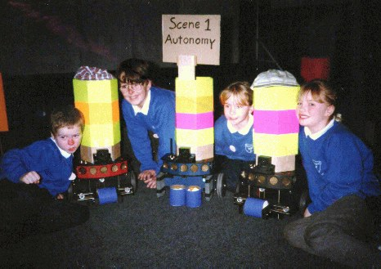
1996 Ullanta Robot Theatre

Slide 16
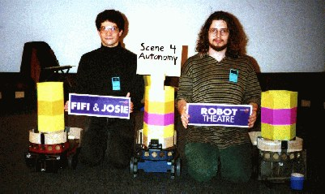
Fifi and Josie: A Tale of Two Lesbiots
A Story of Autonomy, Love, Paranoia, and Agency
Written by Roxanne Linnea Ray This play premiered in April 1996, as part of the Brandeis Festival of the Arts, performed by the Nerd Herd.
A much-improved version, starring Ben, Mae, and Ullanta the Robot Levin was developed by request for the Robotix '97 festival in Glasgow, Scotland, and performed in March of that year.

Slide 17
First robot theatre with mobile and autonomous robots
Scene 1: Autonomy
Fifi and Josie inhabit separate spheres of the lesbiot Universe.
Despite being steeped in lesbiot culture, they each live their lives unaware of the possibilities that love might offer.
In other words, they perform autonomous robotic actions.

Slide 18
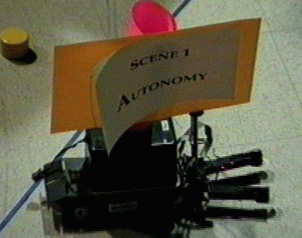
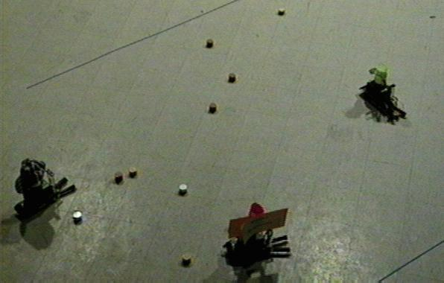
Directed by Barry Brian Werger

Slide 19
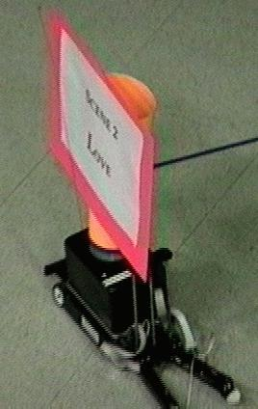
Scene 2: Love
Fifi and Josie begin to notice the attraction they feel for each other.
They fall in love, slowly. Fifi and Josie approach each other - yet at first, they turn away shyly.
When Fifi and Josie do finally make contact, they engage in cooperative actions, slowly negotiating their relationship as all young lovers must.
The new emotions fill their hearts and threaten to overpower them.

Slide 20
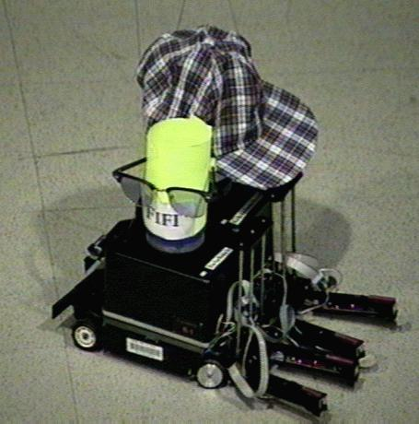
Almost together

Slide 21
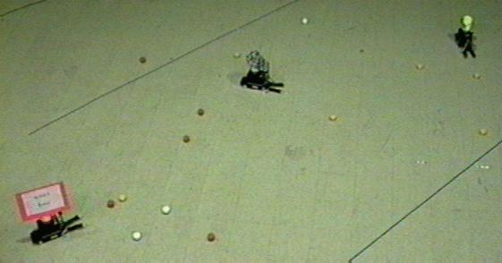

Slide 22
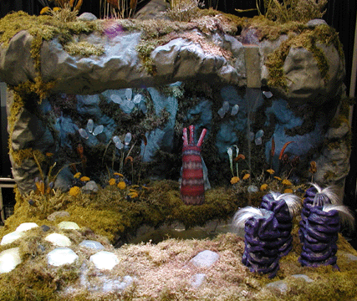
2002. Artificial Life Theatre of Cynthia Breazeal
SIGGRAPH Emerging Technology Exhibit. This exhibit combined several core technologies: Integrated show controls that turn the terrarium into an intelligent stage; interactive, autonomous robot performers with natural and expressive motion that combines techniques from animation and robot control; and real-time, stereo vision that tracks multiple features on multiple people.
Together, these elements create a physically interactive, ever changing, multi-sensory experience (including, sight, sound, touch, and even smell).
The performance follows a storyline where certain elements occur each time, yet audience participation allows the experience to be different every time

Slide 23
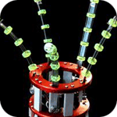
A collaboration between the Robotic Life and Synthetic Characters research groups at the Media Lab and MIT's Artificial Intelligence Lab
Public Anemone (January 2002 - August 2002)
The exhibit featured several autonmous robots peforming on an "intelligent" stage, featuring computer-controlled special effects.
Breazeal envisions that such fully embodied robotic theater could be incorporated into amusement parks, museums, or even interact with human actors on Broadway.

